Slide 1


Egyptian Space Agency
Egyptian Universities Training Satellite Project
EUTS
GCS Antenna Control System
Prepared by
Mansoura university
Faculty of Engineering – Computer Engineering and Control Systems - T28
Summer Training 2022

Slide 2
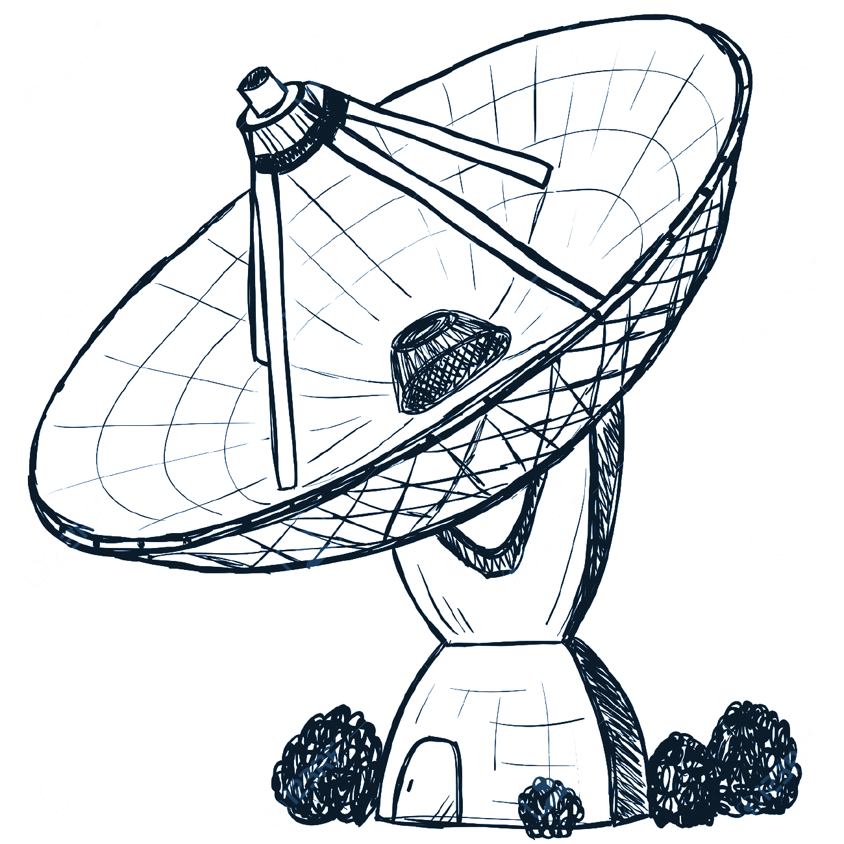
Agenda
Introduction
What is an Antenna ?
Antenna control system
Antenna motion and axes
Controlling antenna
Controller data
Team point of view
System Stages
First Stage (Controlling Using Arduino)
Second Stage (LabView + Encoder)
Third Stage (System Integration)
Final Stage
Manual/Auto states
Encoder feedback

Slide 3
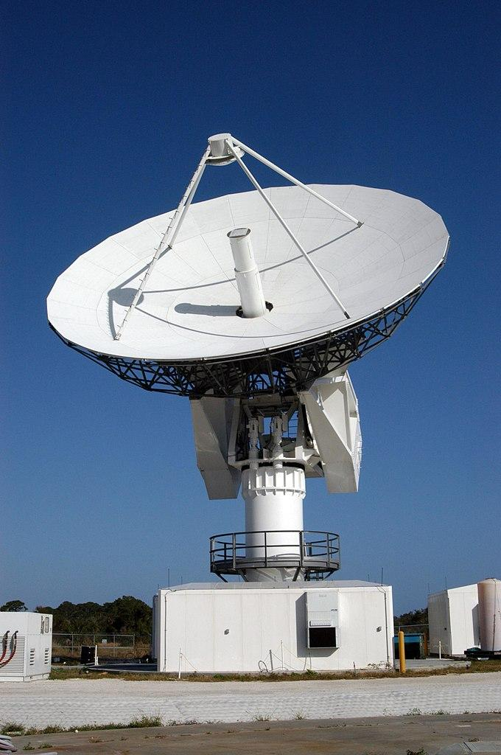
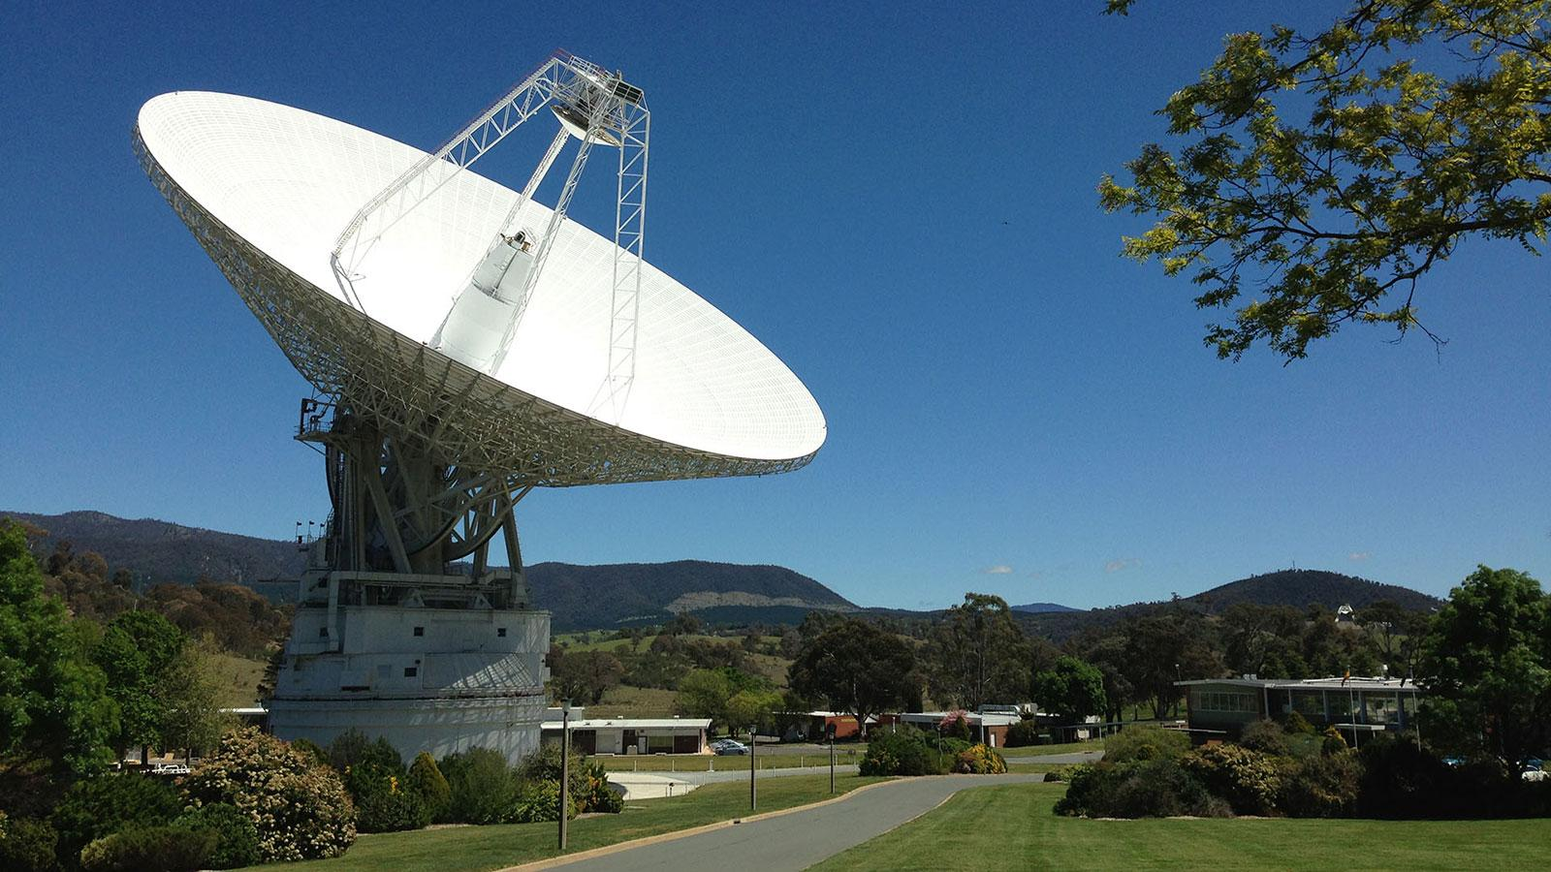
Introduction
What is an Antenna ?
An Antenna is an electrical device that converts electric power into electromagnetic waves (or simply radio waves) and vice-versa, antenna can be used for both Transmission and Reception of electromagnetic radiation .

Slide 4
Introduction
Antenna control system:
Antenna positioning or steering is very important for getting standard broadcast signals from a satellite. The antenna must be pointed at a precise angle to get the strongest possible signal. If the antenna position is adjusted manually, it became too cumbersome to align it at the best possible position.
Therefore, antenna control system is used in order to achieve the best possible position automatically.

Slide 5
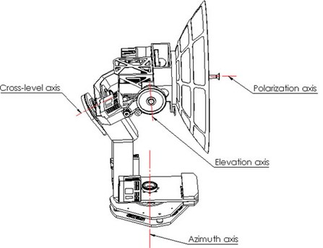
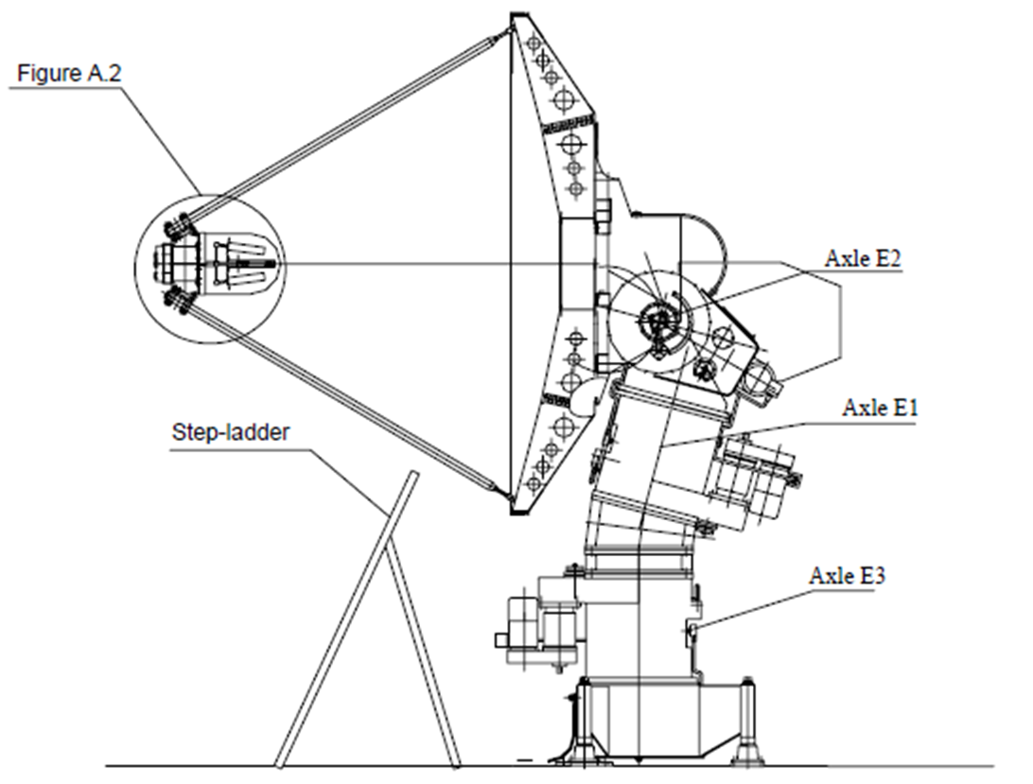
Introduction
Antenna motion and axis:
The number of axes differ according to the motion mechanism, as the number of axes increase the antenna can cover a wide range of space and also the complexity of motion.
Fig.1 Main axes:
Azimuth
Elevation
Cross level axis
polarization
Fig.2 Main axes:
Azimuth
Elevation
Tilt Azimuth
Fig.1
Fig.2

Slide 6
Introduction
Controlling antenna:
Manually:
Using mechanical switches for adjusting the direction of the motion and potentiometer for adjusting motor speed
This will be too cumbersome to align it at the best possible position
Using controller:
The antenna can be controlled automatically using controller
feeding the controller with the required positions it will automatically align the antenna at the best possible position

Slide 7
Introduction
Controller data:
Input
Required position
Setting required position via GUI
feed required positions using a table
Output
Motor control signal
Angle difference
Feedback
Current position
get current position as a feedback from encoder

Slide 8
Team point of view
Team Point of view:
Controlling using arduino
Hardware circuit design
Compromises
Axis number
Motor Limits
Motor start and stop

Slide 9
System Stages
Stages Abstraction:
The system is divided into three stages
Dealing with Azimuth axis at first
Stages required target:
Interfacing with one axis
ATV interfacing
LabView
Read Encoder data
Integrating arduino with labview
ATV Interface Circuit + Arduino Code
LabView + Encoder
Integrating
Full System

Slide 10
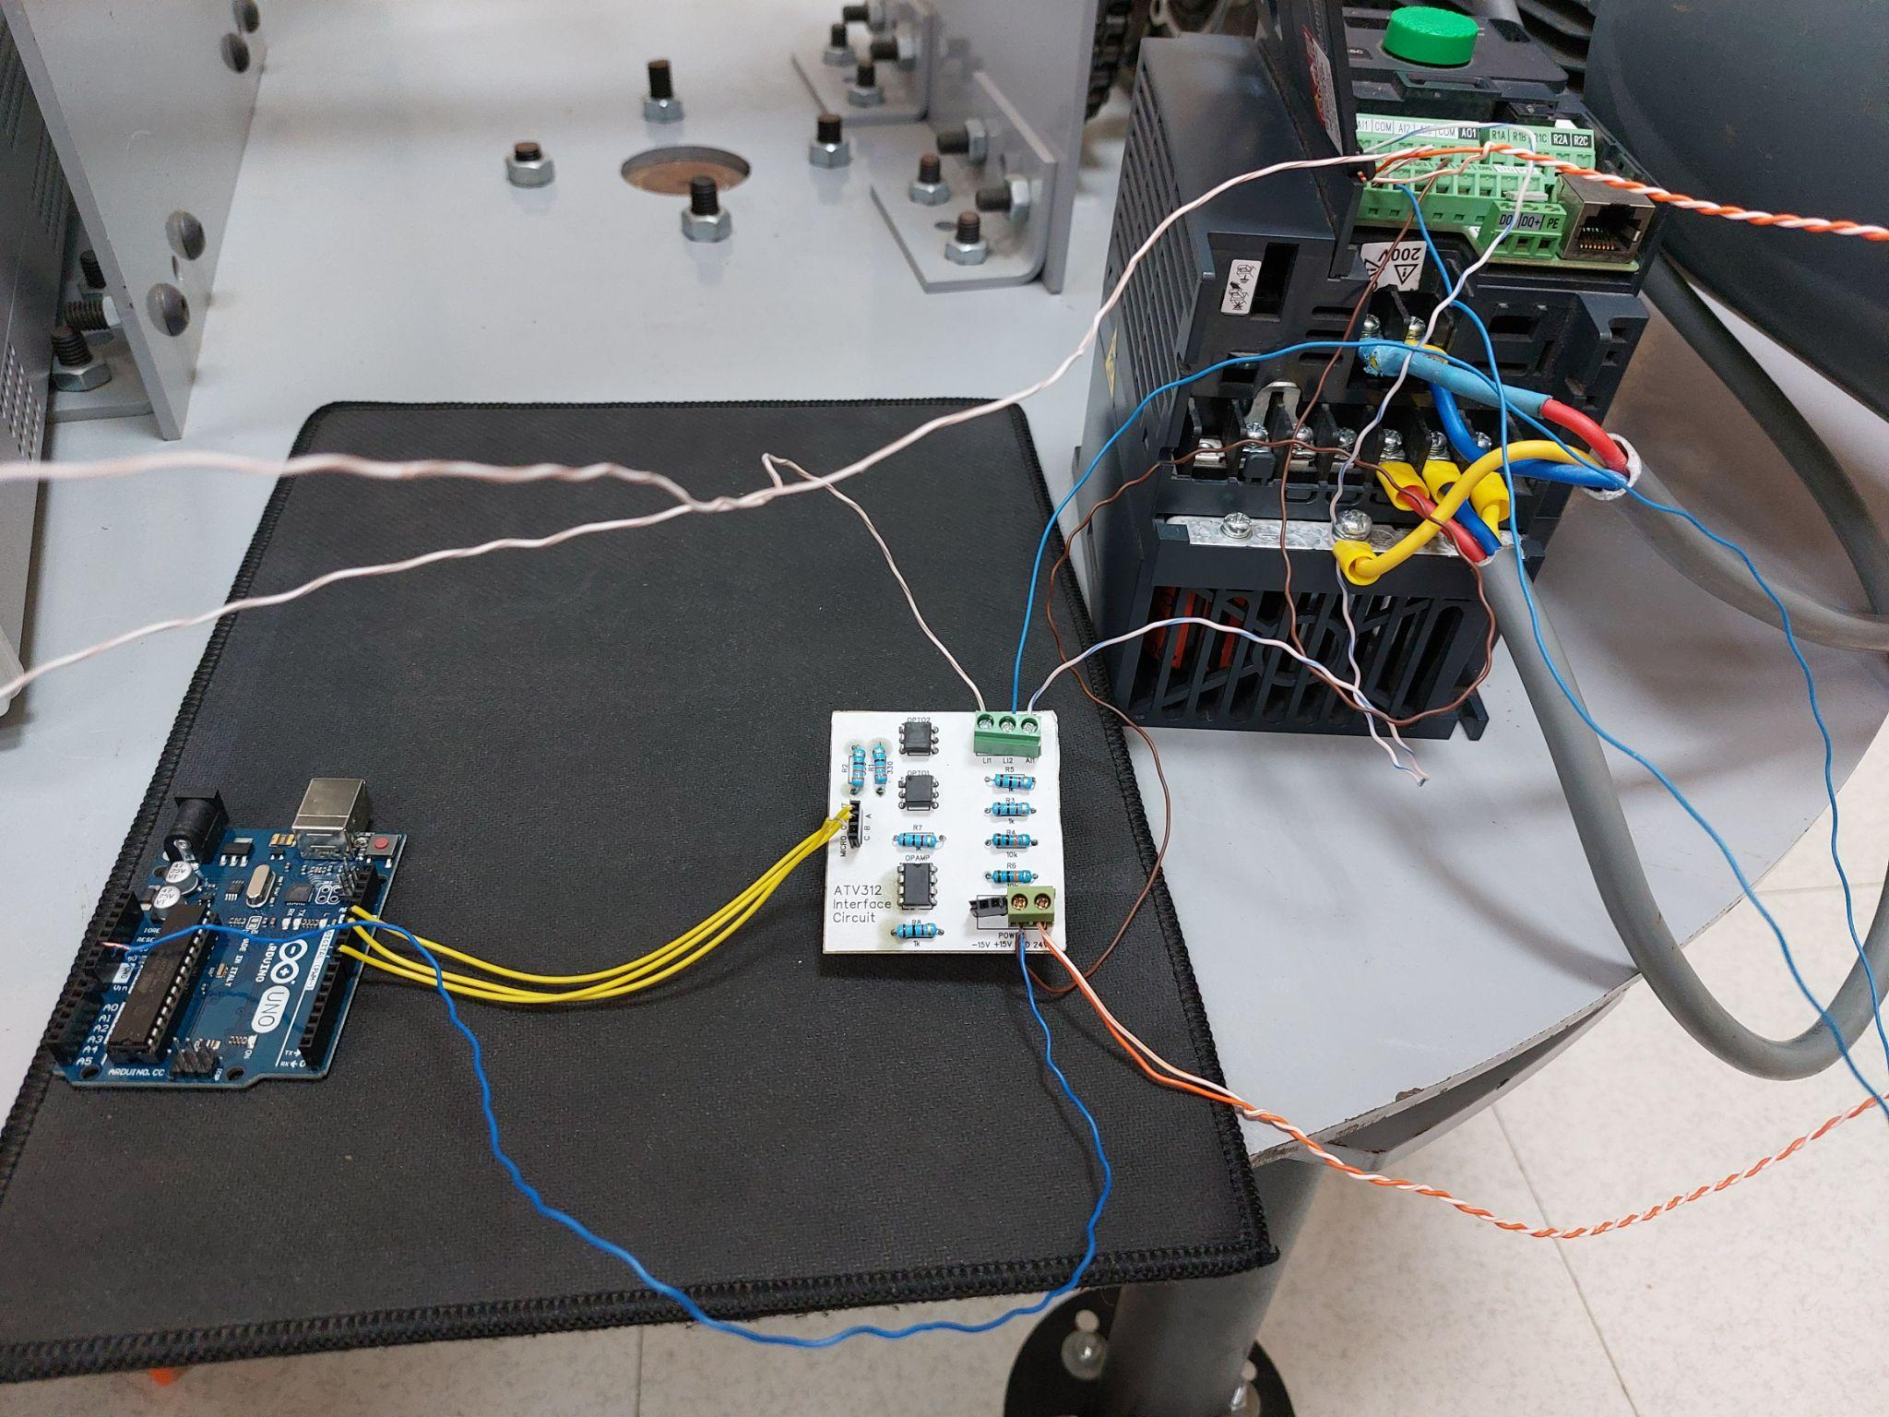
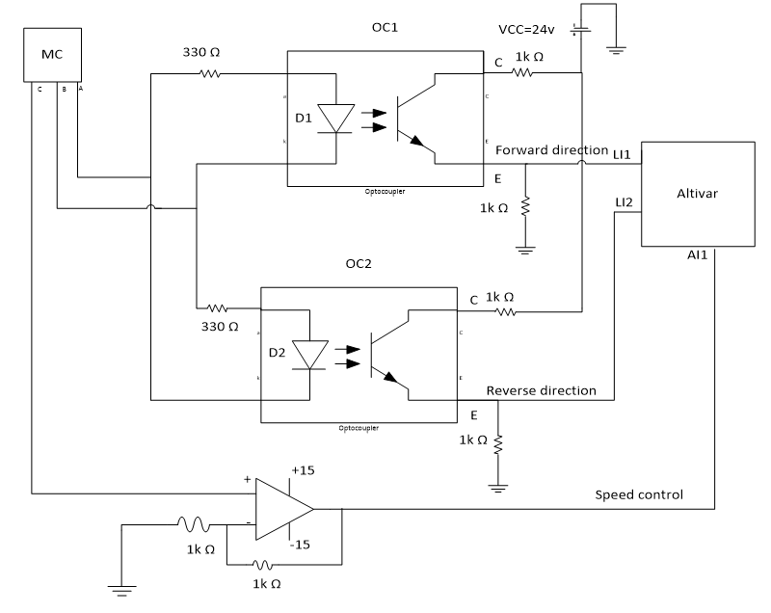
First stage
First Stage:
Interfacing with Altivar
Setting ATV configurations
ATV interface circuit Demo
Controlling using Arduino
Setting Fixed data
Determine Motor Direction
Determine Motor Speed
Determine required time to reach required position

Slide 11
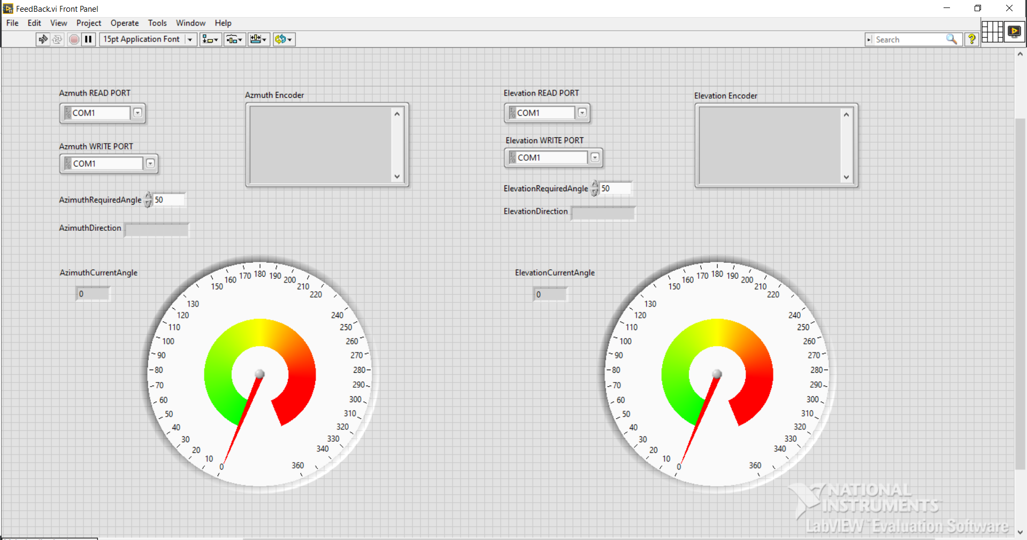
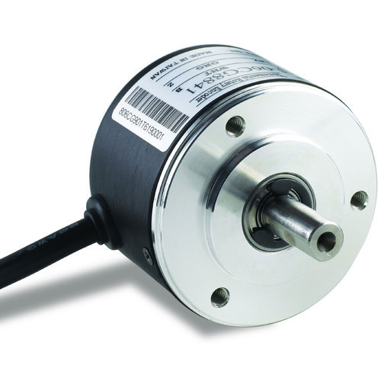
Second stage
Second Stage:
Understanding LabView
Interfacing with Optical Encoder
Sending commands to the Encoder
read data from Encoder
LabView System Block
Reading encoder position using serial port
LabView GUI For presenting Encoder data

Slide 12
Third stage
Third Stage:
Integrating the system
Get Encoder Current Position using serial port
Determine action based on required angle given by the user and send data to arduino
Control the Arduino code using Data sent by LabView
Testing the whole System and checking results

Slide 13
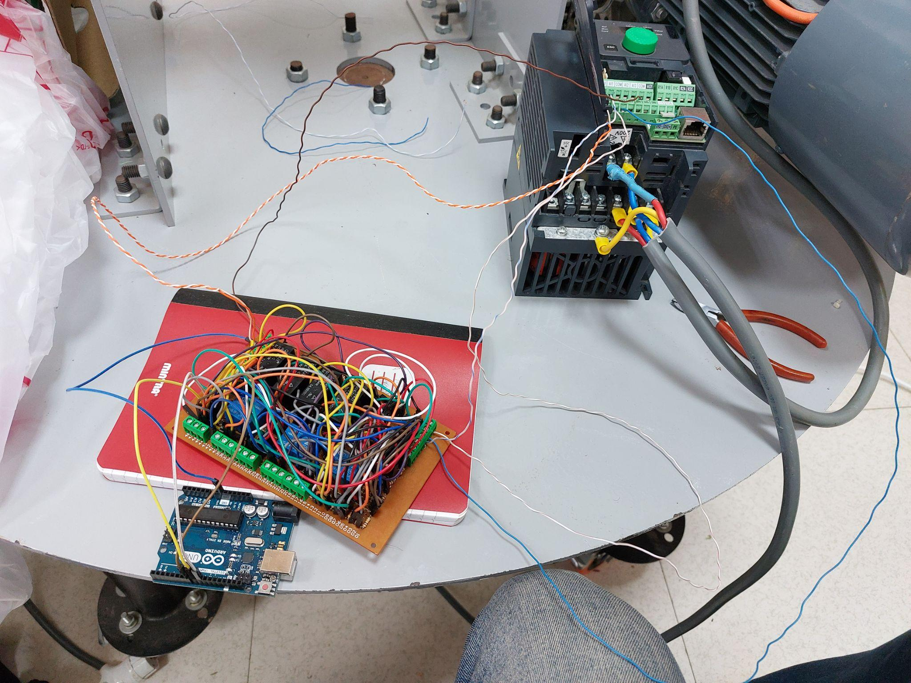
Final stage
Final Stage:
Including one Elevation Axis
Including Manual State
Get Current Position From encoder via Serial Port
Control arduino using LabView GUI
Presenting Current Position on LCD

Slide 14
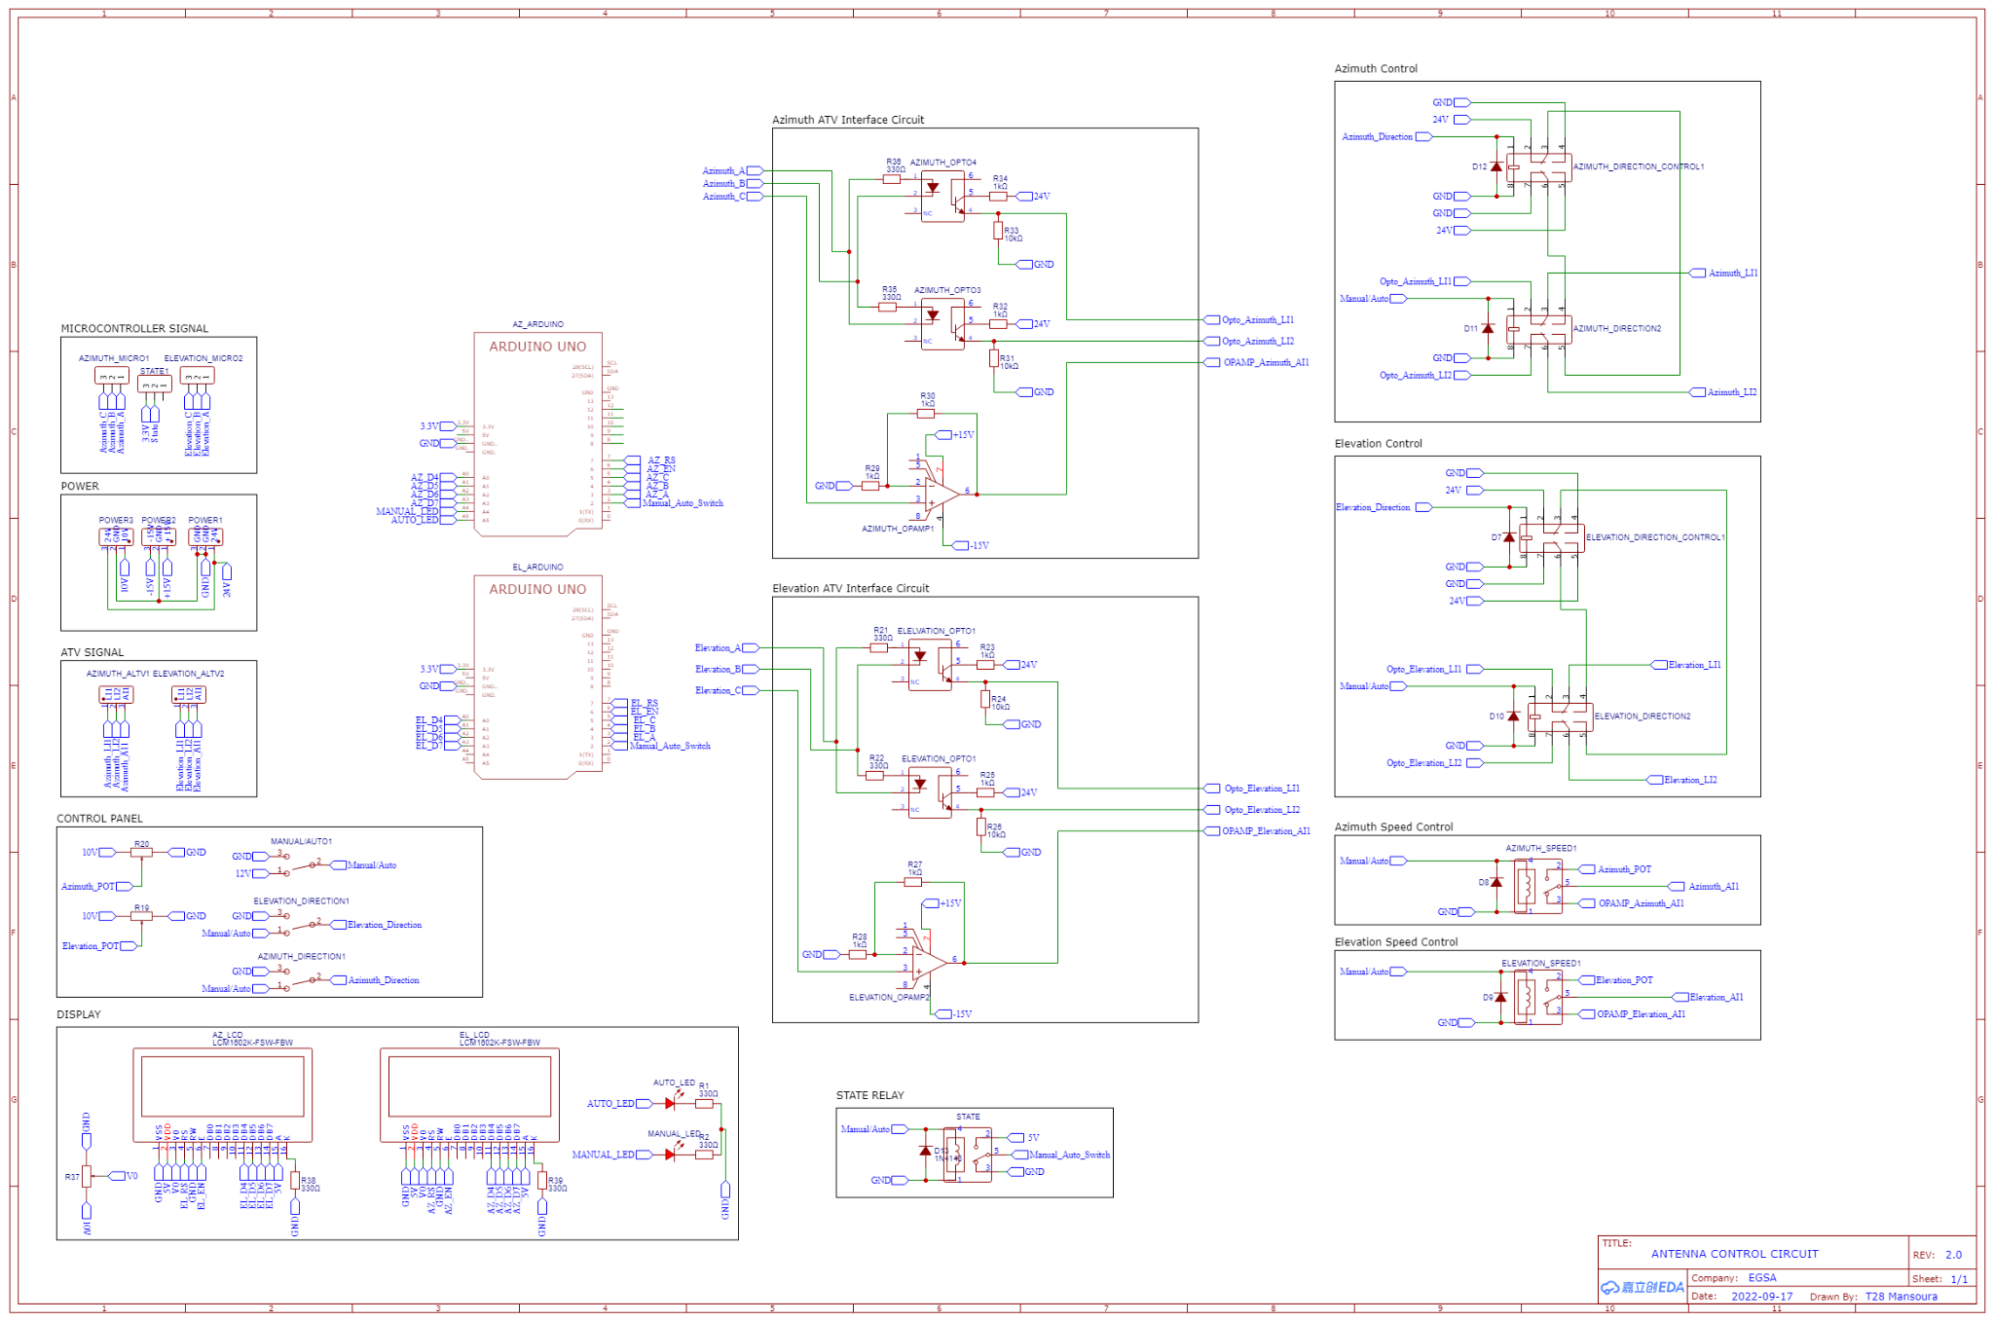
Final stage
Final Circuit
Schematic

Slide 15
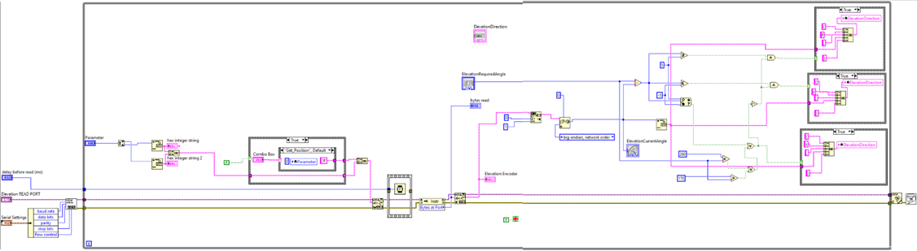
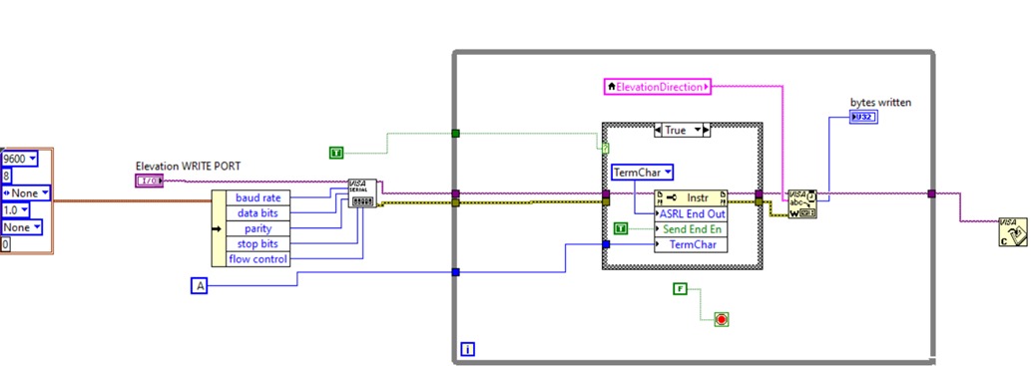
Final stage
LabView
System Block

Slide 16
Thank You

